Slide 1
EE678: Wavelets
Course Project
Contactless Fingerprint Recognition using Wavelets
Presented by
Badal Varshney (19D070015)
Bhavishya (19D070017)
Guided by
Prof. Vikram M. Gadre

Slide 2
Index
Dataset and Pre-Processing
2D DWT
Multilevel DWT
CWT
MRA for Feature Extraction
First and Second-order
Scattering Coefficients
First Layer With Spatial Wavelets
Triplet Loss Function and Learning
Siamese Network
Making Genuine and Imposter Pair
Matching two Fingerprints
Matching using Multiples Prints
Demo- Identification and Verification
Results
References

Slide 3
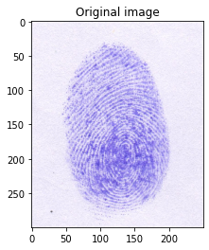
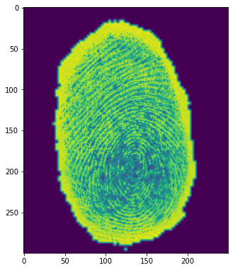
Dataset and Pre-Processing
The dataset contain ink based fingerprints on the white paper.
It contains 600 images taken from 15 subjects i.e. 4 images of each finger/thumb of each person.
(a) Sample Image (b) Pre-Processed Image

Slide 4
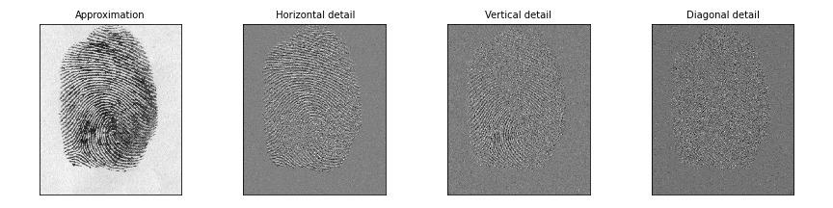
2D Discrete Wavelet Transform
First, we apply a one-level, one dimensional DWT along the rows of the image. Then, we apply a one-level, one-dimensional DWT along the columns of the transformed image from the first step. As the result of these two sets of operations is a transformed image with four distinct bands: (a) LL, (b) LH, (c) HL and (d) HH
Notes:
The LL band corresponds roughly to a down-sampled (by a factor of two) version of the original image. The LH band tends to preserve localized horizontal features, while the HL band tends to preserve localized vertical features in the original image. Finally, the HH band tends to isolate localized high-frequency point features in the image.

Slide 5
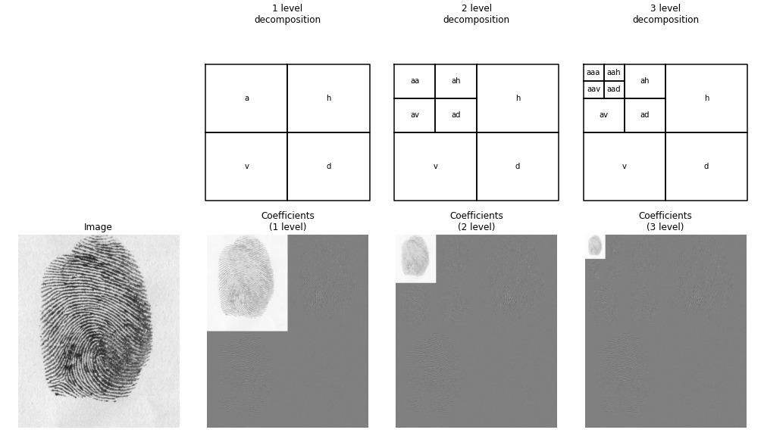
Multilevel Discrete Wavelet Transform
since the one-level, two-dimensional DWT extracts only the highest frequencies in the image
Additional levels of decomposition can extract lower frequency features in the image which are applied only to the LL band of the transformed image at the previous level
Notes:
since the one-level, two-dimensional DWT extracts only the highest frequencies in the image. Additional levels of decomposition can extract lower frequency features in the image; these additional levels are applied only to the LL band of the transformed image at the previous level.

Slide 6
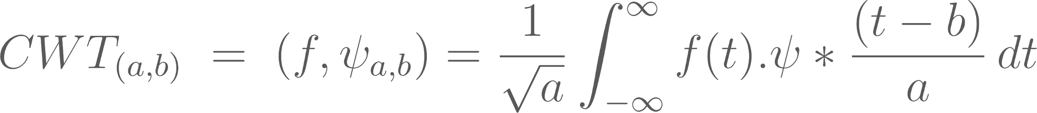
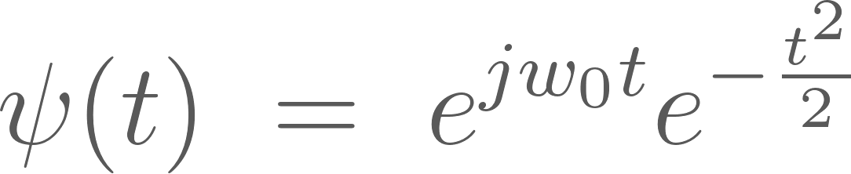
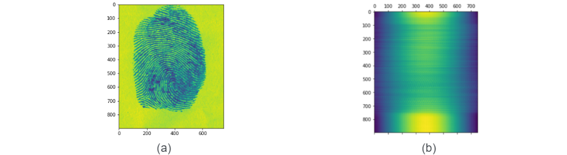
Continuous Wavelet Transform
The CWT of a signal f(t) is given by
We uses the morlet wavelet for computing the cwt coefficients
Notes:
It is defined as adding all the time signals and multiplying by the shift version of the wavelet. The output of the continuous wavelet transform gives the wavelet coefficients as the output.
(f,$\psi_{a,b}$) is the inner product

Slide 7
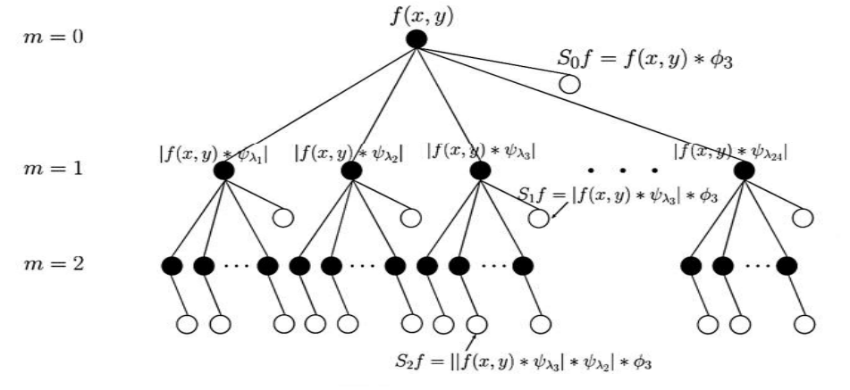
Multiresolution Technique for Feature Extraction
Scattering Wavelet Network

Slide 8


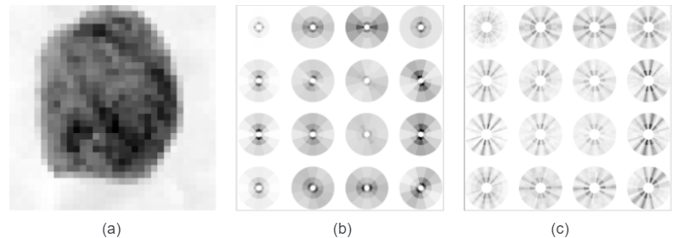
First and Second-order Scattering Coefficients
(a): Image X(u) of a Fingerprint Images. (b): Array of scattering vectors , for m = 1 and u sampled at intervals = 8. (c): Scattering vectors , for m = 2.
Extract the scattering coefficients from the image up to the 2nd order (2nd layers of scatnet)

Slide 9
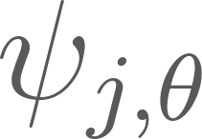
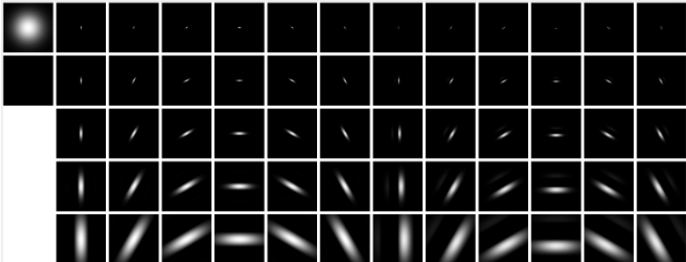
First Layer With Spatial Wavelets
Quadrature phase complex Morlet wavelets , dilated (along rows) and rotated (along columns). Their real and imaginary parts are shown on the left and on the right, respectively.
Notes:
It defines the first wavelet modulus operator $\widetilde{W_1}$. Locally invariant translation and rotation coefficients are first computed by averaging the image x with a rotation invariant low pass filter $\phi_J(u)$ = $2^{-2J} \phi(2^{-J}u)$
For a fingerprint, it is calculated with complex Morlet wavelets. Which are equal to Gabor functions whose mean is set to zero by subtracting a Gaussian.

Slide 10
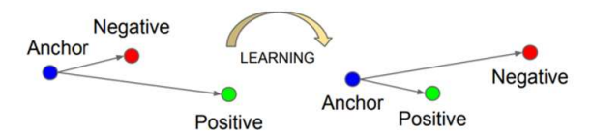
Triplet Loss Function and Learning

Slide 11
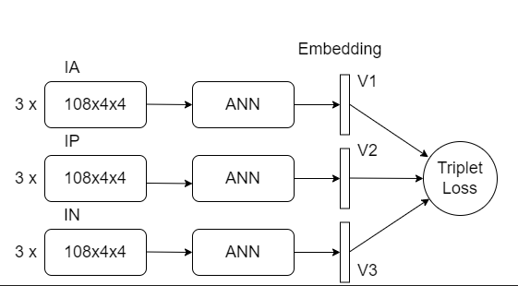
Siamese Network

Slide 12
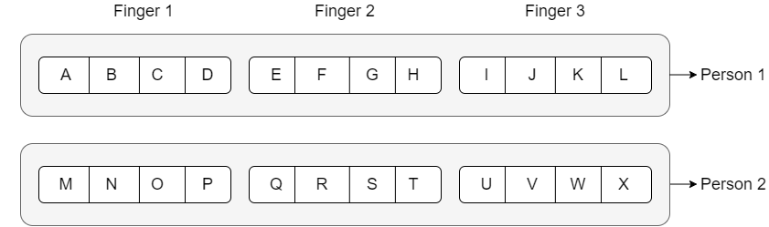
Making Genuine and Imposter Pair

Slide 13
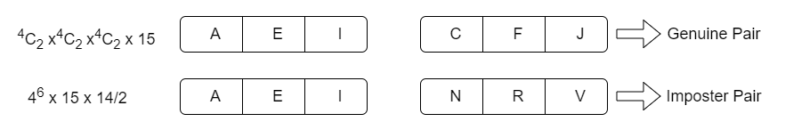
Making Genuine and Imposter Pair
Number of Class = 15
Number of Images = 15x3x3 = 135

Slide 14
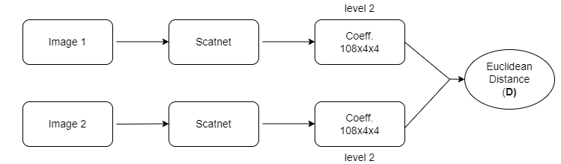
Matching two Fingerprints
Lesser the D, more similar Image 1 and Image 2 will be.

Slide 15
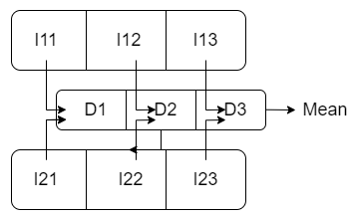
Matching using Multiples Prints
Davg > threshold : Different
Davg < threshold : Same
Results
FN = 21.8%
FP = 20.3%

Slide 16
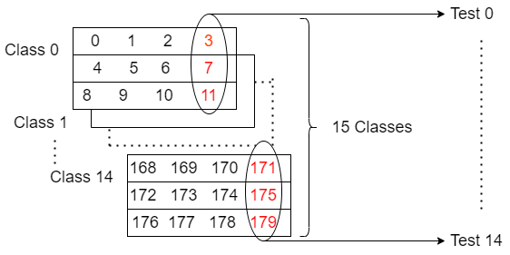
Demo- Identification and Verification

Slide 17
Results
Test | Rank 1 | Rank 2 | Rank 3 | Rank 4
Test 0 | 0 | 5 | 9 | 14
Test 1 | 1 | 12 | 4 | 8
Test 2 | 4 | 6 | 1 | 8
Test 3 | 3 | 11 | 6 | 4
Test 4 | 4 | 6 | 11 | 8
Test 5 | 5 | 4 | 11 | 9
Test 6 | 6 | 4 | 5 | 3
Test 7 | 7 | 4 | 8 | 5
Test 8 | 4 | 8 | 5 | 9
Test 9 | 9 | 4 | 6 | 14
Test 10 | 10 | 4 | 7 | 5
Test 11 | 11 | 5 | 4 | 7
Test 12 | 8 | 12 | 4 | 11
Test 13 | 13 | 6 | 4 | 5
Test 14 | 14 | 6 | 9 | 4

Slide 18
References
J. Bruna and S. Mallat, “Invariant scattering convolution networks,” IEEE Transactions on Pattern Analysis and Machine Intelligence, vol. 35, no. 8, pp. 1872–1886, 2013.
S. Mallat, A Wavelet Tour of Signal Processing, Third Edition: The Sparse Way, 3rd ed. USA: Academic Press, Inc., 2008.
F. Cotter and N. Kingsbury, "A Learnable Scatternet: Locally Invariant Convolutional Layers," \textit{IEEE International Conference on Image Processing (ICIP)}, pp. 350-354, 2019, doi: 10.1109/ICIP.2019.8802977.
Birajdar Parmeshwar, Haria Meet, Kulkarni Pranav, Gupta Shubham, Joshi Prasad, Singh Brijesh, and Gadre Vikram, "Towards Smartphone-based Touchless Fingerprint Recognition," \textit{Sādhanā}, Vol. 44, No. 7, pp. 1 - 15, 2019.
Cotter, Fergal, and Nick G. Kingsbury. “Deep Learning in the Wavelet Domain,” ArXiv abs/1811.06115, 2018.
S. A. Grosz, J. J. Engelsma, E. Liu, and A. K. Jain, "C2CL: Contact to Contactless Fingerprint Matching," \textit{IEEE Transactions on Information Forensics and Security}, Vol. 17, pp. 196-210, 2022, doi: 10.1109/TIFS.2021.3134867.
A. Malhotra, A. Sankaran, M. Vatsa, and R. Singh, "On Matching Finger-Selfies using Deep Scattering Networks," \textit{IEEE Transactions on Biometrics, Behavior, and Identity Science}, Vol. 2, No. 4, pp. 350-362, Oct. 2020, doi: 10.1109/TBIOM.2020.2999850.
Jannis Priesnitz , Rolf Huesmann , Christian Rathgeb , Nicolas Buchmann , Christoph Busch, "Mobile Touchless Fingerprint Recognition: Implementation, Performance and Usability Aspects," \textit{Sensors}, Vol. 22, No. 3, pp. 792, 2022.
Stéphane Mallat. “Group Invariant Scattering”. en. In: Communications on Pure and Applied Mathematics 65.10 (Oct.2012), pp. 1331–1398.
Edouard Oyallon and Stephane Mallat, “Deep Roto-Translation Scattering for Object Classification,” 2015, pp. 2865–2873.a

Slide 19
Thank You

